Slide 1
SuperFatorial
https://github.com/glauco-vinicius/SuperFatorial

Slide 2
Leitura sequencial

Slide 3
Leitura com NIO
import java.io.IOException; import java.nio.file.Files; import java.nio.file.Path;

Slide 4
Leitura com NIO
public void reader(String nome, int key) throws IOException { Path path = Paths.get(nome); super.setKey(key); List<String> linhasArquivo = Files.readAllLines(path); for (String linha : linhasArquivo) { this.add( linha ); } }

Slide 5
Leitura com NIO
private void add(String linha) { String[] value = linha.split(SEPARATOR); Integer key = Integer.parseInt(value[0]); BigInteger data = new BigInteger(value[1].trim()); if( key.equals(super.getKey())) { super.setValue( data ); conteudo.put(key, data); } }

Slide 6
Leitura sequencial NIO com lambda em Java 8

Slide 7
Leitura sequencial com NIO usando lambda
Map<Integer, BigInteger> conteudo = Files.lines(Paths.get(nome)).filter(
line -> line.split(SEPARATOR)[KEY_INDEX].equals(Integer.valueOf(key).toString())) .map(line -> line.split(SEPARATOR)) .collect(Collectors.toMap(line -> Integer.valueOf(line[KEY_INDEX].trim()), line -> new BigInteger(line[DATA_INDEX].trim())));
// $ ulimit -Hn 1024

Slide 8
Leitura randomica

Slide 9
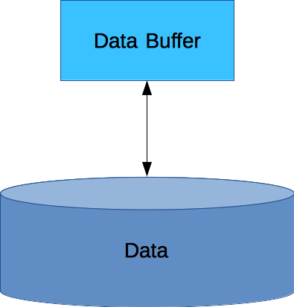
Buffer de dados
Reservatório temporário

Slide 10
Uso do buffer
Escrever os dados;
Invocar buffer.flip(): - Coloca o em modo de leitura.
Ler os dados do buffer - Esvaziao;
Invocar buffer.clear() ou buffer.compact(): - Volta para modo escrita

Slide 11
Leitura randômica
final int RECORD_SIZE_IN_BYTES = 23;
final int BUFFER_SIZE_IN_BYTES = RECORD_SIZE_IN_BYTES
Path path = Paths.get(nome);
ByteBuffer buff = ByteBuffer.allocate(BUFFER_SIZE_IN_BYTES);
String encoding = System.getProperty("file.encoding");
SeekableByteChannel sbc = Files.newByteChannel(path, EnumSet.of(READ));
Long offset = (long) (RECORD_SIZE_IN_BYTES * key);
sbc.position(offset);
sbc.read(buff);
buff.flip();

Slide 12
Leitura randômica
0,1############# 1,1############# .
.
. 11,39916800##### 12,479001600#### 13,6227020800### 14,87178291200## 15,1307674368000

Slide 13
0,1############# 1,1############# .
.
. 11,39916800##### 12,479001600#### 13,6227020800### 14,87178291200## 15,1307674368000

Slide 14
Leitura randômica
final int RECORD_SIZE_IN_BYTES = 23;
final int BUFFER_SIZE_IN_BYTES = RECORD_SIZE_IN_BYTES
Path path = Paths.get(nome);
ByteBuffer buff = ByteBuffer.allocate(BUFFER_SIZE_IN_BYTES);
String encoding = System.getProperty("file.encoding");
SeekableByteChannel sbc = Files.newByteChannel(path, EnumSet.of(READ));
Long offset = (long) (RECORD_SIZE_IN_BYTES * key);
sbc.position(offset);
sbc.read(buff);

Slide 15
Leitura randômica
buff.flip();
String line = Charset.forName(encoding).decode(buff).toString();
this.setKey(Integer.parseInt(line.split(SEPARATOR)[KEY_INDEX]));
this.setValue(new BigInteger(line.split(SEPARATOR)[DATA_INDEX].trim()));
buff.rewind();
buff.clear();

